Slide 1
welcome computer network
*---------presentation--------*

Slide 2
Topics
Wide area network
Routing
Routing tables
link state routing
Open shortest path first
Flodding
Broadcasting
Multicasting
Congestion & dead lock

Slide 3
wide area network introduction
A wide-area network (WAN) is the technology that connects your offices, data centers, cloud applications, and cloud storage together .It is called a wide-area network because it spans beyond a single building or large campus to include multiple locations spread across a specific geographic area, or even the world.

Slide 4
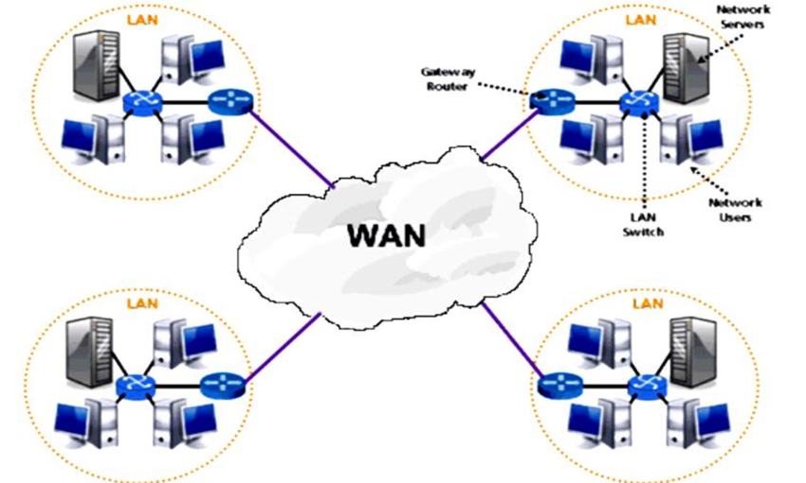
Types of wan
Circuit-Switched WANs.
Packet-Switched WANs.
Leased Line WANs.
MPLS (Multiprotocol Label Switching) WANs.
PUBLIC WANs (Internet-based WANs)
Private WAN.
SD-WAN.
Wireless WAN.

Slide 5
Advantage of wan disadvantage of wan
Large geographical area coverage.
Centralized infrastructure.
Network security.
Increased bandwidth with the use of leased lines, as opposed to broadband connections.
High setup cost.
Possible security gaps.
Antivirus software and firewall requirements.

Slide 6
----Routing----
A Router is a process of selecting path along which the data can be transferred from source to the destination. Routing is performed by a special device known as a router.
A Router works at the network layer in the OSI model and internet layer in TCP/IP model
A router is a networking device that forwards the packet based on the information available in the packet header and forwarding table.
.

Slide 7
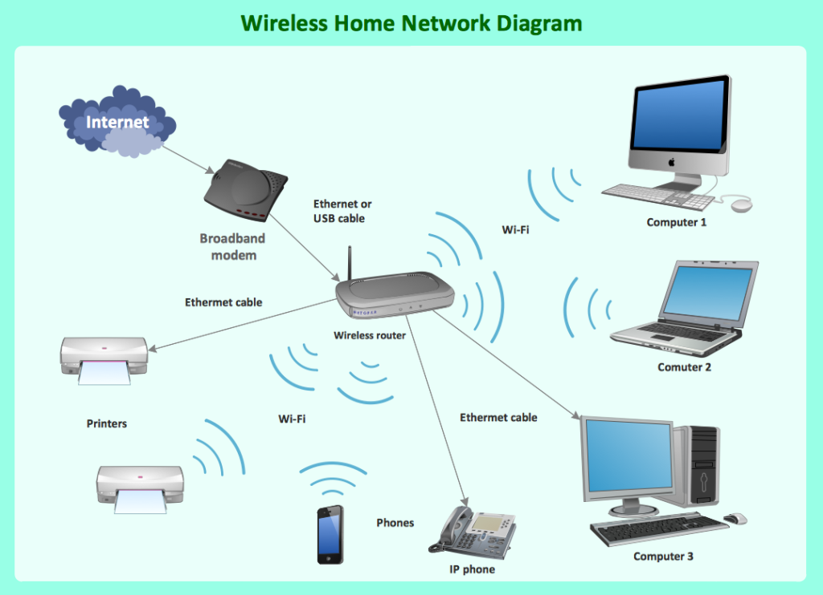
Types of routing
Routing can be classified into three categories:
Static Routing
Default Routing
Dynamic Routing

Slide 8
Static Routing
Static Routing is also known as Nonadaptive Routing.
It is a technique in which the administrator manually adds the routes in a routing table.
A Router can send the packets for the destination along the route defined by the administrator.
In this technique, routing decisions are not made based on the condition or topology of the networks
Dynamic Routing
It is also known as Adaptive Routing.
It is a technique in which a router adds a new route in the routing table for each packet in response to the changes in the condition or topology of the network.
Dynamic protocols are used to discover the new routes to reach the destination.
Default Routing is used when networks deal with the single exit point.
It is also useful when the bulk of transmission networks have to transmit the data to the same hp device.

Slide 9
Advantage disadvantage
Network Connectivity
Increased Security
Quality of Service (QoS)
Easy to Set Up and Manage
Limited Bandwidth
Vulnerability to Cyberattacks
Limited Range
Cost

Slide 10
**Routing table**
A routing table is a set of rules, often viewed in table format, that's used to determine where data packets traveling over an Internet Protocol (IP) network will be directed. This table is usually stored inside the Random Access Memory of forwarding devices, such as routers and network switches.

Slide 11
How Does a Routing table work…
A router has to make decisions on which interface it has to deliver the packets. A routing table helps the router to take these decisions effectively.
The routing table helps a router with the following most important piece of information:
It tells the destination IP address to the router.
It tells the best path to the router to reach the destination.
It also helps the router to manage the network traffic every second

Slide 12
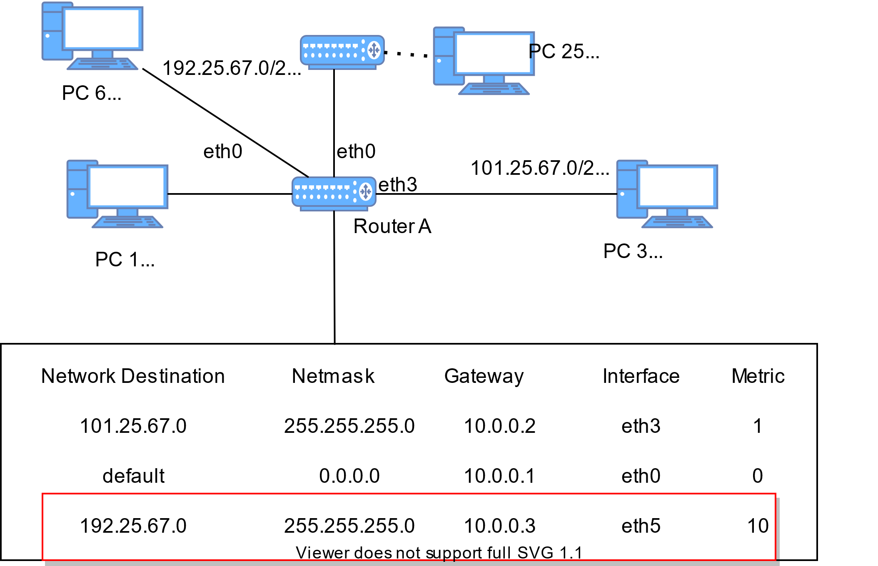

Slide 13
the routing table as shown in the image above, the 3 metrics are the most important:
Network destination:
It consists of the network ID of the destination.
Net mask:
It consists of the subnet mask of the destination IP address.
Interface:
It refers to the port at which the router is connected to the network.

